Slide 2
Learning objectives
In this lesson students will learn to:
In this lesson you will learn to:
  Explain why secondary storage is needed
  Describe how data is stored on magnetic, optical and solid-state media.
For more details on this topic and additional student activities see Topic 3 of the student book.
© Pearson Education Ltd 2020. Copying permitted for purchasing institution only.
Notes:
Specification content: 3.1.2

Slide 3
General purpose devices
The computing devices you use most of the time are ‘general purpose’ computers.
Desktops, laptops, smartphones, and tablets can be used for a huge variety of purposes. New software can be downloaded and installed to give additional functionality.
The reason computers exist as we know them is because of the stored program concept, conceived in the 1940s by Von Neumann and Alan Turing.
Remember that in the time before devices were able to store programs, they needed to be rebuilt or rewired in order to perform a different task
© Pearson Education Ltd 2020. Copying permitted for purchasing institution only.

Slide 4
Secondary storage
In everyday computer use, you need a way to write data and to store data when your computer is switched off. You also need a way to retrieve data the next time you switch your computer back on.
RAM allows you to write data and store it … but this data is lost when your computer is switched off (because RAM is volatile memory).
Therefore, you need some way of reading and editing data AND storing the data when the computer has no power.
© Pearson Education Ltd 2020. Copying permitted for purchasing institution only.
Notes:
https://student.craigndave.org/videos/gcse-edexcel-topic-3a-the-need-for-secondary-storage
Student Activity 1

Slide 5
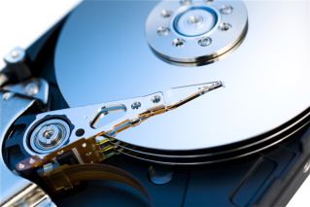
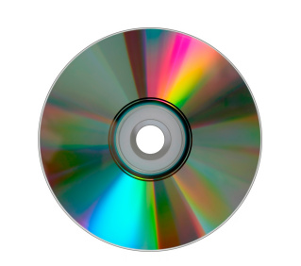

Storage technologies
There are three main types of storage
technology that computers use:
  magnetic
  optical
  solid state.
There is a difference between a storage device and the medium that it uses to store information.
  A DVD drive reads from and writes data to an optical disk medium.
  A hard disk reads from and writes data to a magnetic platter medium.
  A USB drive reads from and writes data to a solid-state/flash medium.
© Pearson Education Ltd 2020. Copying permitted for purchasing institution only.
Notes:
DVD is an abbreviation for Digital Versatile Disk or Digital Video Disk. USB stands for Universal Serial Bus. It is actually an industry standard for communication, not a device at all. So, when talking about this type of storage, it is important to say USB drive or USB device, rather than just USB.

Slide 6
Magnetic
Magnetic media are coated with a substance that can be magnetised.
Magnetic storage technology works by magnetising parts of this substance as north and south poles to represent binary 1s and 0s.
Examples:
  hard disk drive
  tape drive.
© Pearson Education Ltd 2020. Copying permitted for purchasing institution only.

Slide 7
Optical
Optical media consist of a platter with a flat reflective surface.
Optical storage technology works by using a laser to burn ‘pits’ into the flat surface. The reflective areas between pits are known as ‘lands’.
A laser is directed onto the medium’s surface. When it hits a ‘land’ the beam reflects (this is read as a 1) but when it hits a ‘pit’, the beam does not reflect (this is read as a 0).
Examples:
  DVD
  CD.
© Pearson Education Ltd 2020. Copying permitted for purchasing institution only.

Slide 8
Solid state
Solid-state media consist of silicon chips that feature a special kind of transistor called NAND flash. This type of media is called ‘solid state’ because it has no moving parts.
Solid-state technology works by using a large electric current to force electrons through a barrier, trapping them in positions called ‘pools’.
A full pool represents 0 and an empty pool represents 1.
Examples:
  SSD cards
  USB flash drive.
  The flash of the electric current used to achieve this gives us the name for this type of memory.
© Pearson Education Ltd 2020. Copying permitted for purchasing institution only.
Notes:
https://student.craigndave.org/videos/gcse-edexcel-topic-3a-common-types-of-storage
Student Activity 2

Slide 9
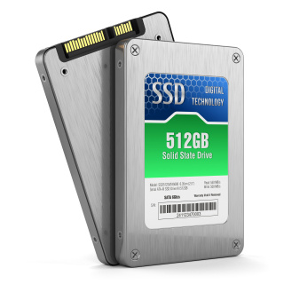

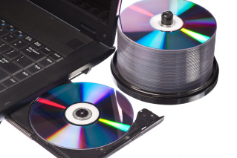
Recap
Identify the type of storage:
© Pearson Education Ltd 2020. Copying permitted for purchasing institution only.

Slide 10
Wrap up: you have learned how to…
Explain why secondary storage is needed.
  RAM is volatile which means that its content is lost when its power is switched off.
Describe how data is stored on magnetic, optical and solid-state media.
  Magnetic uses the polarisation of particles on a disk to represents
  1s and 0s.
  Optical uses a laser and the pits and lands on the surface of a disk to represent 1s and 0s.
  Solid state uses electrons forced into pools to represent 1s and 0s.
© Pearson Education Ltd 2020. Copying permitted for purchasing institution only.

